Slide 1
AI-Generated Text Detection
Group 12
Animesh Chaudhary (achaud81@asu.edu)
Siddhant Gahoi (sgahoi@asu.edu)
Sougata Nayak (snayak31@asu.edu)

Slide 2
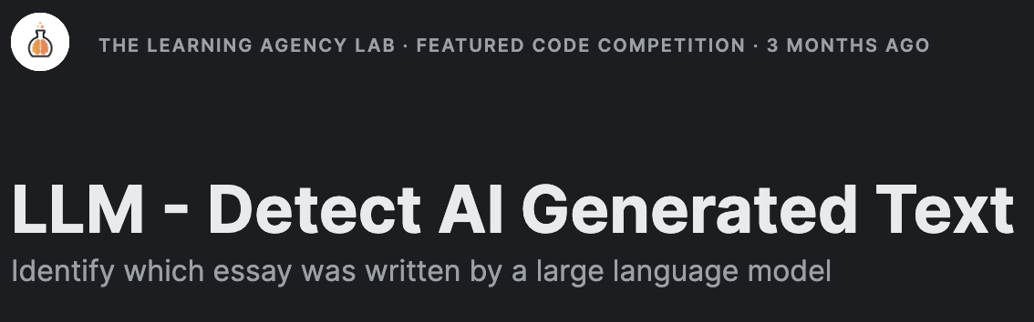
Motivation
Motivation
Responsibility
Technology
Motivation
The exponential growth of Large Language Models (LLMs) has sparked concerns regarding academic integrity, as students may exploit these models to produce sophisticated content, undermining essential learning processes. 70% of educators express worries about the potential misuse of LLMs in academic settings.
Upholding academic standards and preventing plagiarism are paramount. A study highlights the need for reliable detection methods, given the ease with which AI-generated text can mimic human writing.
Ensuring the authenticity of digital content is crucial for maintaining trust in academic publications and media. Emphasis is given on the importance of transparency in AI usage to mitigate the risks associated with the proliferation of LLMs.

Slide 3

Approach
Data Analysis
Understanding dataset characteristics, including text features and distributions of human vs. AI-generated essays.
Key insights gained from analyzing prompt IDs and text lengths.
Model Development
Implementation of three machine learning models: DistillBERT, ALBERT, and DebertaV3.
Develop robust models capable of accurately distinguishing between student-written and LLM-generated essays.
Evaluation
Rigorous testing of models against a hidden test set to assess generalizability and real-world effectiveness.
Comparison of model performance in terms of accuracy and effectiveness in detecting AI-generated text.
The "LLM - Detect AI Generated Text" competition, hosted on Kaggle by Vanderbilt University and The Learning Agency Lab, tackles vital challenges in discerning between human-authored and large language model (LLM)-generated essays, promoting transparency in academia.

Slide 4
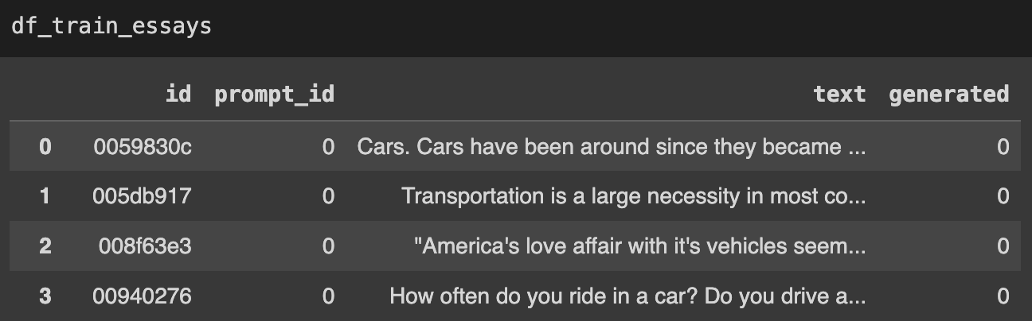
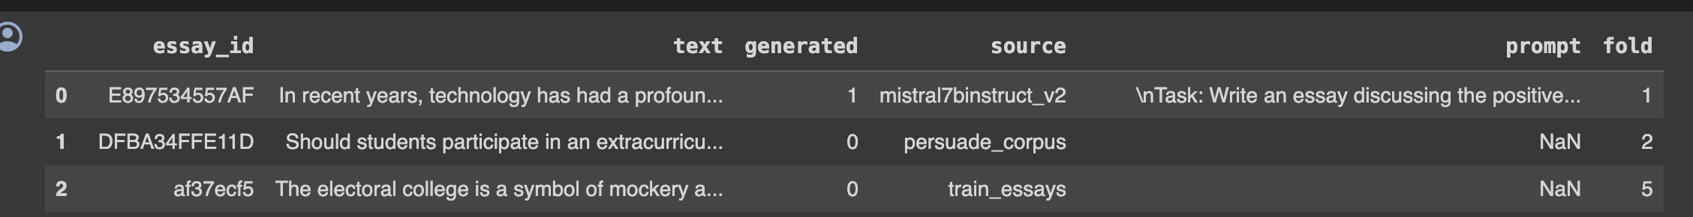
Datasets
Competition Dataset: This dataset consists of approximately 10,000 essays, sourced from responses to various prompts. The essays are marked by their origin—either human-written or generated by large language models (LLMs). Each essay in the dataset is labeled to indicate whether it was generated by an LLM or written by a human student. Additionally, each essay has unique identifiers such as id and prompt_id.
DAIGT Proper Train Dataset: Specifically created for the "LLM - Detect AI Generated Text" competition, this dataset includes a curated collection of essays generated by various LLMs. It incorporates contributions from different sources such as the Persuade corpus, essays generated with Llama-70b and Falcon180b, and essays produced by individual users with models like ChatGPT. The dataset is updated over time to include additional examples, essay IDs, generation prompts, and a stratified 10-fold split based on the source dataset.

Slide 5
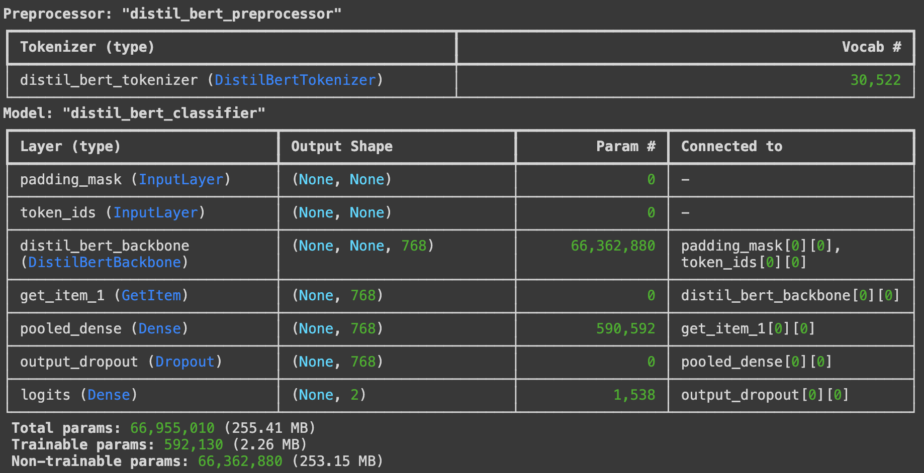
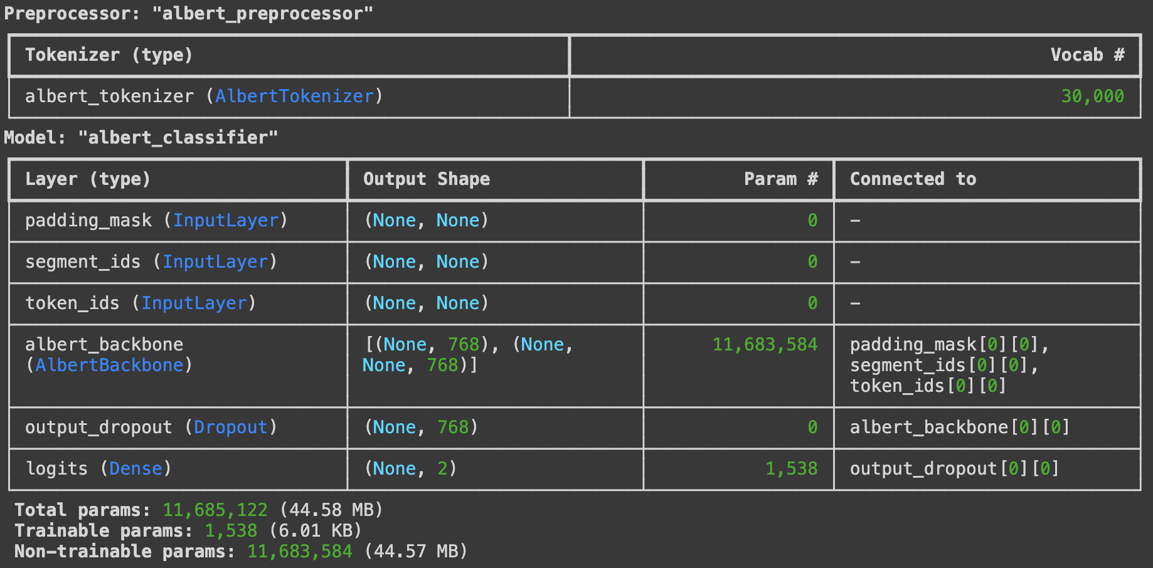
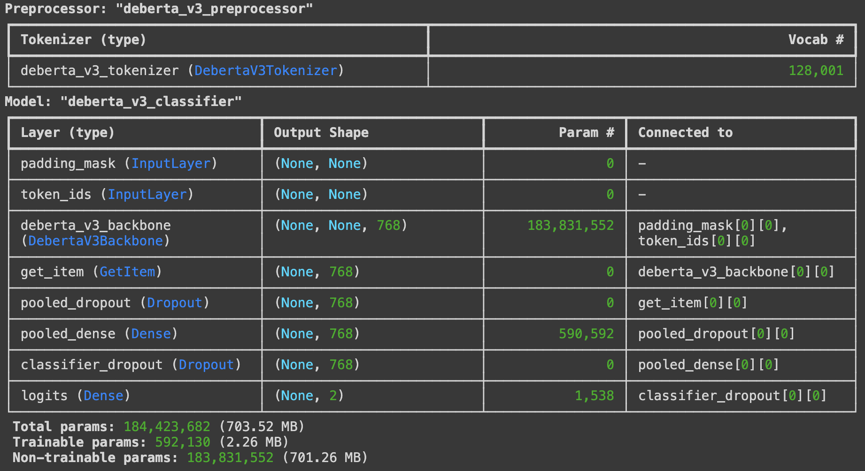
Models
DistillBERT
Streamlined version of BERT, maintains performance with fewer parameters. Ideal for various NLP tasks like classification, sentiment analysis.
ALBERT (A Lite BERT)
Reduces computational cost while preserving effectiveness. Suitable for resource-constrained environments and tasks like conversational AI.
DebertaV3
Advanced self-attention mechanisms capture intricate patterns effectively. Well-suited for high precision tasks like question answering, document summarization.

Slide 6
Experiments
For DistillBERT:
Data preprocessing: Loaded datasets and augmented them with additional essays.
Data exploration: Visualized prompt IDs and essay lengths to understand dataset characteristics.
Model preparation: Built and trained the DistillBERT model using Keras and TensorFlow, with a sequence length of 512.
Model training: Split the dataset, compiled the model, and trained it on the training set.
Model evaluation: Tested the trained model's performance on the testing set and computed accuracy and AUC metrics.
For ALBERT:
Data loading and exploration: Similar to DistillBERT, with visualization of prompt IDs and essay lengths.
Data preprocessing: Concatenated external training essays and prepared text data.
Model building and training: Defined model architecture, compiled, split data, and trained.
Model evaluation: Generated predictions, evaluated performance metrics, and visualized results.
For DebertaV3:
Data loading and exploration: Followed a similar pattern as the other models.
Data preprocessing: Concatenated external essays and prepared text data.
Model building and training: Defined model architecture, compiled, split data, and trained.
Model evaluation: Generated predictions, evaluated performance metrics, and visualized results, similar to the other models.

Slide 7
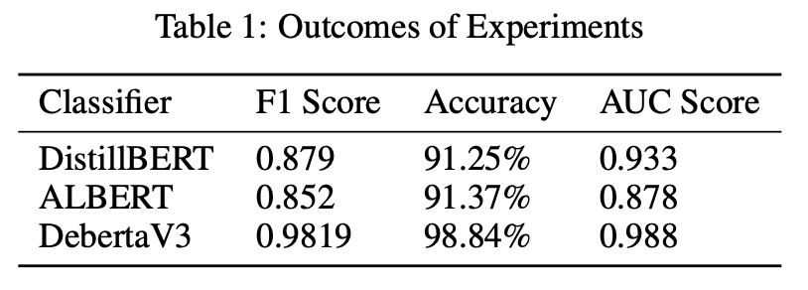
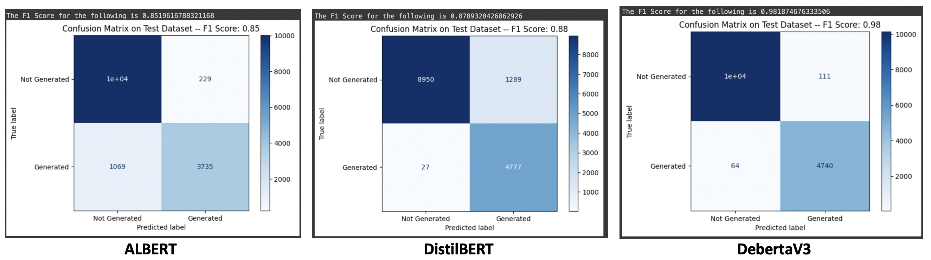
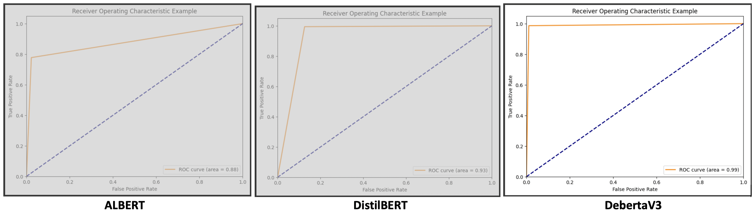
Outcomes and Results
Overall, while each model has its strengths and weaknesses, DebertaV3 stands out for its exceptional performance and ability to capture nuanced information from text data.

Slide 8
Future Work
Possible future directions for the project:
Model Fusion and Ensemble Learning: Explore combining predictions from DistilBERT, ALBERT, and DebertaV3 through ensemble techniques to potentially enhance performance and robustness.
Model Compression and Optimization: Explore techniques like quantization and pruning to create more efficient versions of ALBERT and DebertaV3, suitable for deployment on resource-constrained devices.
Evaluation on Diverse Datasets: Conduct thorough evaluations across various datasets and benchmarks to assess generalization capabilities and identify areas for improvement.

Slide 9


The End

